Slide 1
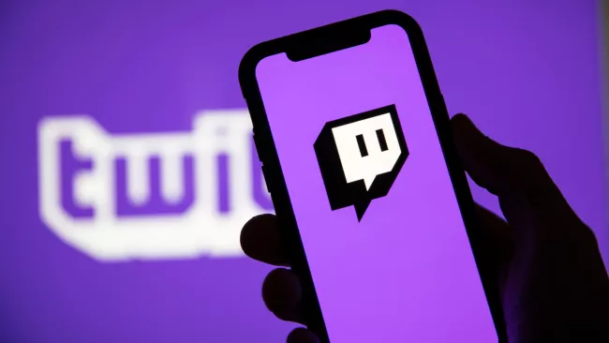

Video Game Streaming ~
Does this new form of entertainment infringe on copyright?
Whether you’re new to the streaming world due to Covid19 or you’ve been a patron for years, there are legal implications that many do not think of when considering starting up a channel.
By Anli Roets
Notes:
Picture Credits:
Shutterstock: https://cdn.mos.cms.futurecdn.net/rP2H723xYVPHsEFikvT2i6-650-80.jpg.webp
https://www.twitch.tv/jacksepticeye

Slide 2
What is Twitch.tv and Video Game Livestreaming
According to Twitch.tv:
Twitch is where millions of people come together live every day to chat, interact, and make their own entertainment together.
Notes:
https://www.twitch.tv/p/en/about/

Slide 3
Some Data on Streaming
Data Available at: twitchtracker.com/statistics

Slide 4
More Stats: 2020 thus far
Minutes watched on Twitch.tv is up 59.8%
Monthly Streamers are up 75%
Average Concurrent Viewers is up 61%
Average Concurrent Live Channels is up 69%
Amount of Twitch Partners is up by 28%

Slide 5
Why would law ever be an issue?
Developers, under copyright law, own every element to the game as well as the rights to use of said game.
Companies such as Nintendo are not fond of High-Profile Streamers, especially when that streamer crosses beliefs held by that company.
“A DMCA Takedown is:
When content is removed from a website at the request of the owner of the content or the owner of the copyright of the content. It is a well established, accepted, internet standard followed by website owners and internet service providers.” – directly from DMCA.com
Notes:
https://www.polygon.com/2017/9/10/16285188/pewdie-pie-racist-slur-firewatch-retaliation-dmca
https://www.polygon.com/2017/11/6/16612080/youtube-nintendo-super-mario-odyssey-demonetization
https://www.essentiallysports.com/esports-news-twitch-streamers-hit-with-dmca-claims/

Slide 6
Why has there been a downward trend of actions against streamers?
Me First!!!
One Theory that is popularly debated is that Streamers have a Fair Use argument to use videogames just like many other content creators may have.
Developers such as Microsoft and Ubisoft are supportive of streamers in a “Fair Use” manner, however, they are opposed by companies such as Nintendo.
Now Me, Now Me!!!
Notes:
https://arstechnica.com/gaming/2018/01/to-stream-or-not-to-stream-how-online-streaming-game-videos-exist-in-an-ip-world/
https://www.cbc.ca/news/entertainment/youtube-gaming-pewdiepie-fair-use-1.4309312

Slide 7
Articles and Reports Worth Noting
Streamin Video Games: Copyright Infringement or Protected Speech?
written by Eirik Jungar of Uppsala University
The (still) uncertain state of video game streaming online.
written by Willie Clark of Arstechnica
Twitch Revenue and Usage Statistics 2020
written by Mansoor Iqbal of Business of Apps
What is Twitch?
written by Joseph Yaden of Digital Trends
Notes:
https://arstechnica.com/gaming/2018/01/to-stream-or-not-to-stream-how-online-streaming-game-videos-exist-in-an-ip-world/
https://www.businessofapps.com/data/twitch-statistics/#1
https://www.digitaltrends.com/gaming/what-is-twitch/

Slide 8
In Other News:
Nintendo takes legal action against creator ‘pokeprincxss’ now named ‘digitalprincxss’ for using their Pokemon franchise in adult themed entertainment on TikTok, Instagram and other online platforms. Even after an emotional change in her online presence she was quoted "Reminder to please be kind to Nintendo and not harass them. I am on Nintendo’s side and even though I showed emotion about the name change I still respect and understand why did had to. I love Nintendo and so should you."
American Congresswoman Alexandria Ocasio-Cortez moves her campaign battle online, attracting close to 430,000 viewers while streaming a new popular game Among Us. The point behind the stream? Not to promote one side or another even though she is part of the Democratic party, rather the point was to get young people to the poles in the upcoming American election.
Notes:
https://www.nintendolife.com/news/2020/10/popular_twitch_and_tiktok_star_pokeprincxss_has_been_sued_by_Nintendo
https://www.tiktok.com/@digitalprincxss?language=en&sec_uid=MS4wLjABAAAADSfDn3lP8BVvYJuwqPT8oseegG5nwqNu6pxm0PWzzImGnc-0KgY40wYziRIi-gAD&u_code=d3em2a990159k7&utm_campaign=client_share&app=musically&utm_medium=ios&user_id=6632471715718905862&tt_from=copy&utm_source=copy&source=h5_m\
https://nationalpost.com/news/world/we-are-here-to-vote-blue-aocs-twitch-stream-of-video-game-among-us-attracts-430000-viewers

